Slide 1

Your Journey with RNNs Continues
Further Exploration
Practical Application
Community Engagement
Dive deeper into advanced topics like Transformers and Generative Adversarial Networks (GANs) for sequence data.
Apply your knowledge to real-world projects such as natural language understanding, financial forecasting, or bioinformatics.
Join online forums, attend workshops, and contribute to open-source projects to enhance your skills and network.
Thank You!
We appreciate your time and engagement in understanding Recurrent Neural Networks and their practical applications in deep learning.
For any further questions, please feel free to reach out.

Slide 2




What is Sequence Data and Why Does It Matter?
Sequence data is information where order matters, like words in a sentence or stock prices over time. The difference between "The cat sat on the mat" and "Mat the on sat cat the" demonstrates why sequence matters in communication.
Weather Forecasting
Yesterday's temperature helps predict today's conditions, showing how historical data informs future predictions.
Netflix Recommendations
Movies you watched in order influence future suggestions, creating personalised viewing experiences.
Oil Well Drilling
Previous drilling data helps optimise current operations, improving efficiency and reducing costs.
Traditional neural networks treat each input independently, but Recurrent Neural Networks (RNNs) have "memory" to handle sequential data effectively.

Slide 3
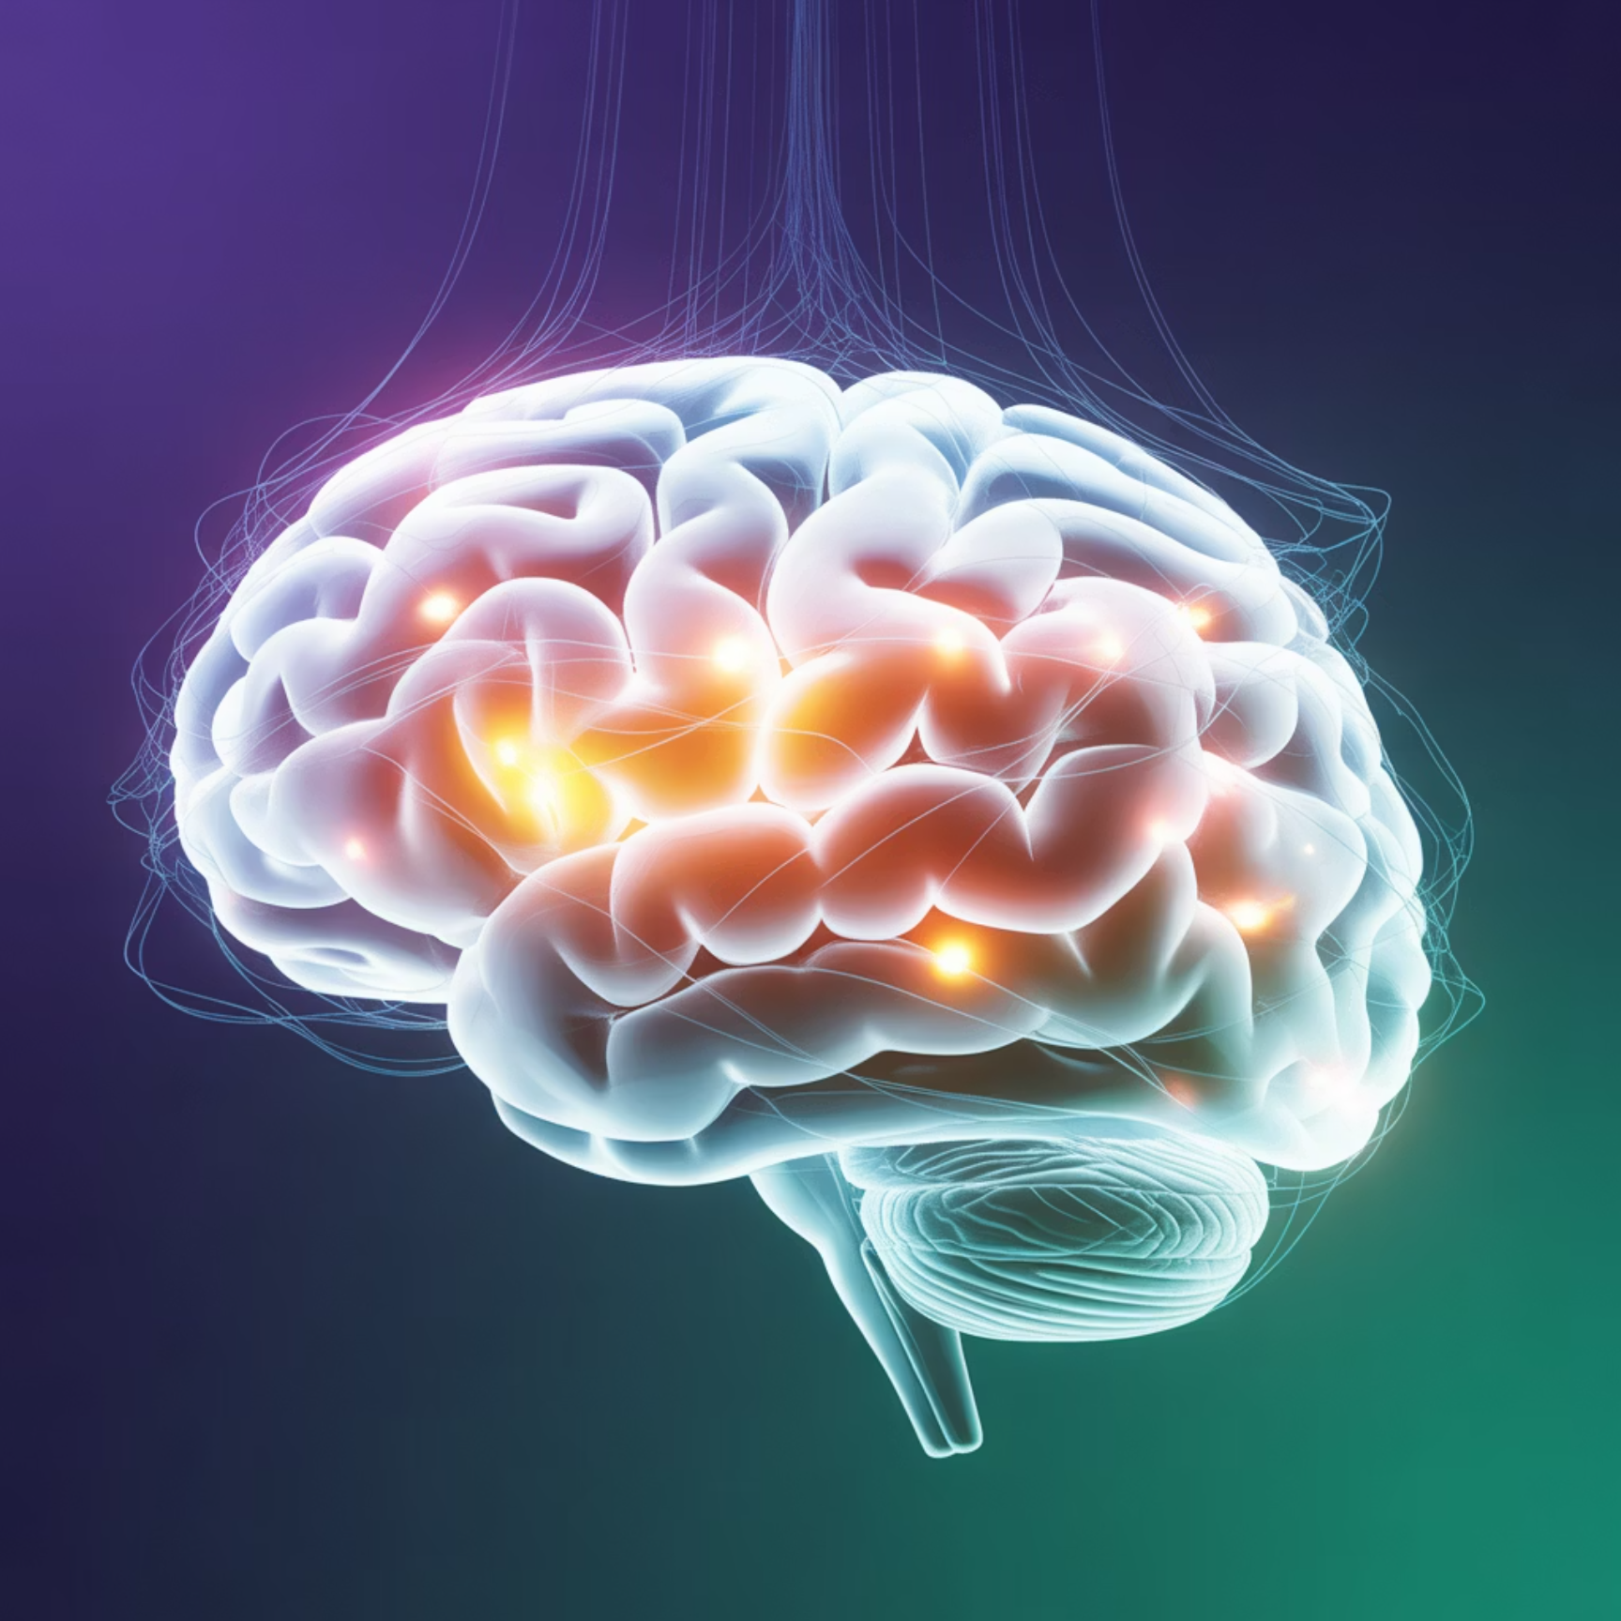
How Human Memory Works vs Computer Memory
Human Conversation
Friend: "I went to the new restaurant downtown"
You: "How was it?" (You remember the restaurant context)
Friend: "The pasta was amazing!" (Context flows naturally)
Traditional Neural Networks
RNNs Introduction
Each input processed independently, like having amnesia with no memory of previous inputs.
Maintain hidden state like short-term memory, where each step influences the next, perfect for sequential data processing.

Slide 4



Unfolding Time: From Loops to Linear Processing
Understanding computational graphs requires thinking about how information flows through time, similar to an assembly line in car manufacturing.
Assembly Line Analogy
RNN Unfolding Process
Each station depends on previous station's work. Worker at Station 3 needs output from Station 2, with information flowing forward through time.
Folded view shows compact representation with loops. Unfolded view expands across time steps, making backpropagation through time possible.
Key insight: Same parameters shared across all time steps. Example: Predicting next word in "The weather today is ___"

Slide 5
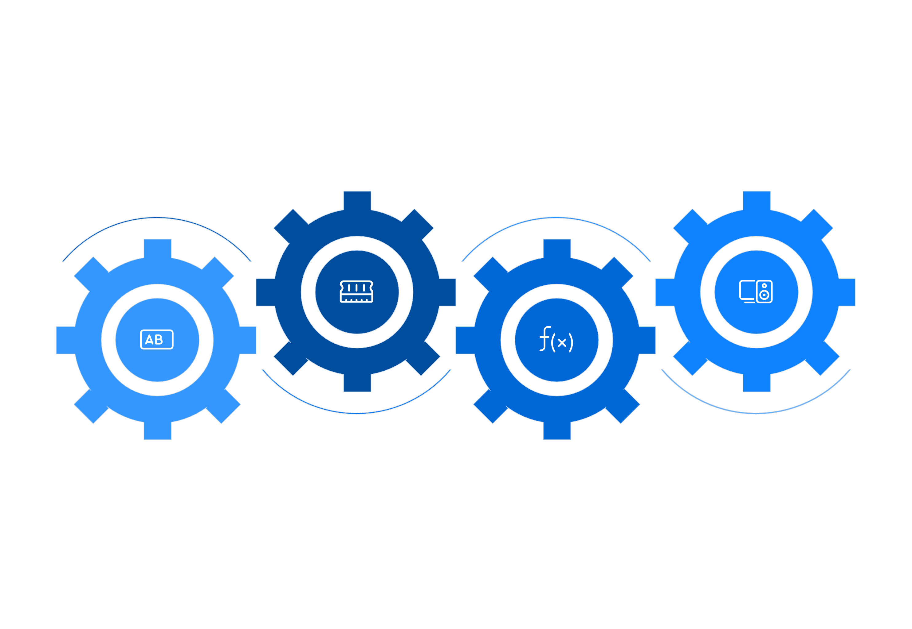




The Building Blocks of Recurrent Networks
Hidden h
Output y
Memory from previous steps
Prediction from current state
Input x
Update
Current data point (e.g., word)
h_t = f(Wx + Uh_{t-1})
Input (x)
Hidden State (h)
Current data point, such as the current word in a sentence or today's stock price.
Network's memory from previous steps, carrying forward relevant information from the past.
Output (y)
Weights
Prediction at current step, based on current input and accumulated memory.
Shared parameters across all time steps, enabling consistent processing throughout the sequence.
GPS Navigation Example: Input is current location, hidden state contains route history and traffic patterns, output provides next direction recommendation.

Slide 6
Why RNNs Share Parameters Across Time
Parameter sharing in RNNs works like language learning - grammar rules apply to all sentences, not just specific ones. The same patterns work for "I eat" and "You eat" - learn once, apply everywhere.
Efficiency
Generalisation
Memory
One set of parameters for all time steps reduces computational overhead and memory requirements significantly.
Works with sequences of any length, from short phrases to long documents, without architectural changes.
Only need to store one set of weights, making the model more memory-efficient and easier to deploy.
Practical Examples: Email spam detection uses same rules for word patterns whether email has 10 words or 100 words. Stock price prediction applies same patterns for any trading day.

Slide 7
Different Ways to Use RNNs in Real Life
One-to-Many: Image Captioning
Many-to-One: Sentiment Analysis
Many-to-Many: Translation
Input: Single image of a cat. Output: "A gray cat sitting on a windowsill". Used for automatic alt-text for visually impaired users.
Input: "This movie was absolutely terrible and boring". Output: Negative sentiment. Used for social media monitoring for brands.
Input: "Hello, how are you?" (English). Output: "Hola, ¿cómo estás?" (Spanish). Different input and output lengths.
Many-to-Many (Same Length): Part-of-speech tagging converts "The quick brown fox" to "Article Adjective Adjective Noun".

Slide 8
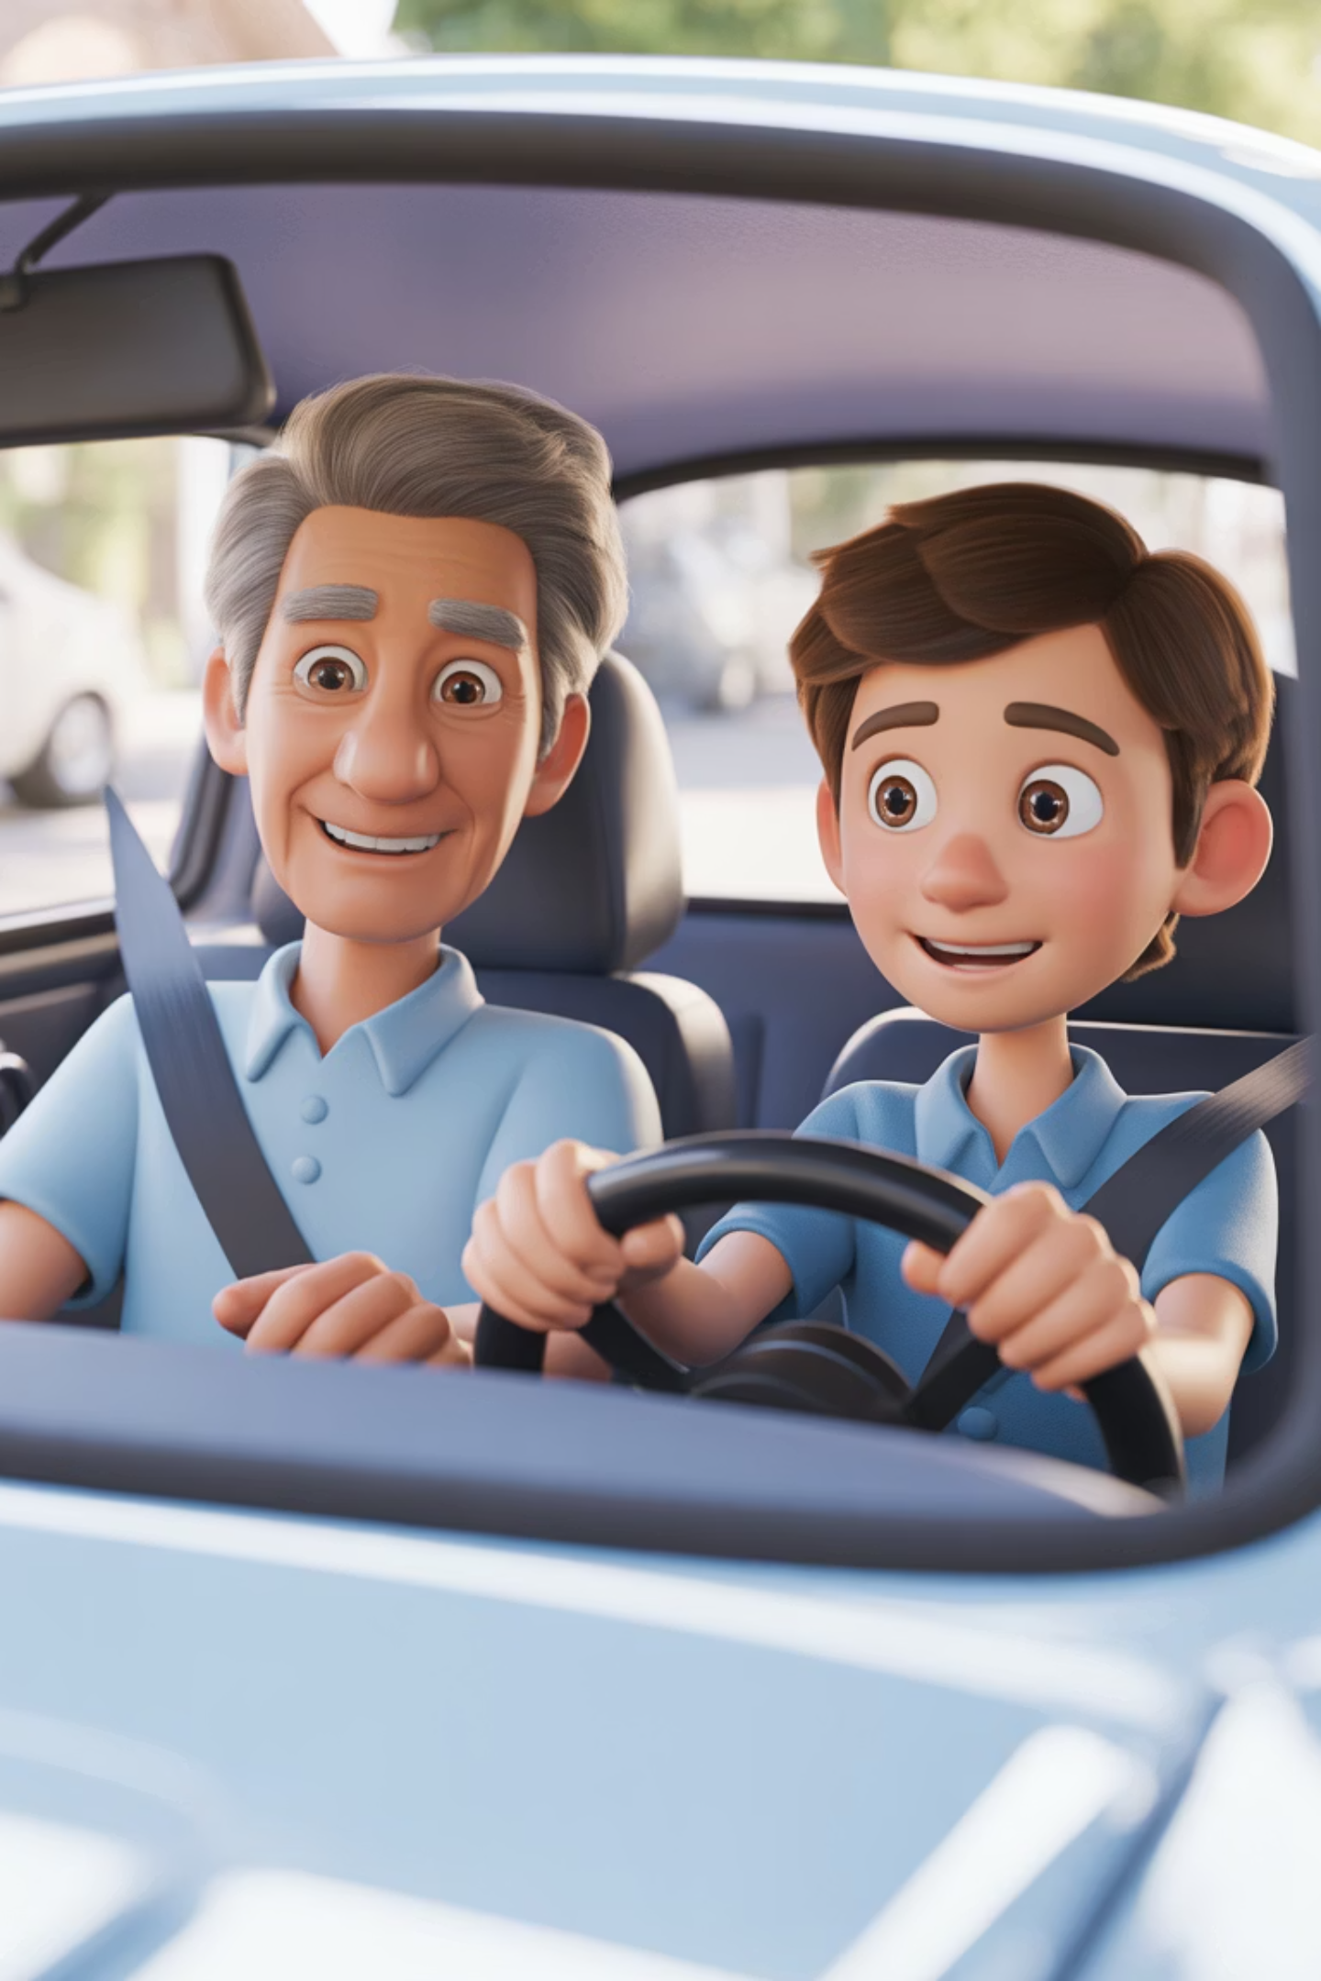

How RNNs Learn from Experience
01
Forward Pass
Process sequence from start to end, like practicing a driving route multiple times to understand the path.
02
Calculate Loss
Compare predictions with actual results, similar to an instructor pointing out driving mistakes during practice.
03
Backward Pass
Calculate gradients through time, like reflecting on what went wrong during the driving lesson.
04
Update Weights
Adjust parameters to improve performance, equivalent to adjusting driving technique based on feedback.
Key Challenge: Gradients can vanish or explode over long sequences. Advanced architectures like LSTM provide the solution.

Slide 9

Why RNNs Forget Long-Term Information
The Telephone Game Problem
Imagine a message "The red car is fast" being passed through 10 people. By the end, it becomes "The bed star is last" - information degrades with each step, just like gradients in RNNs.
Technical Explanation
Gradients become smaller through multiplication
Long sequences cause gradients to approach zero
Network can't learn long-term dependencies
Email Classification
Language Modelling
Time Series
Can't remember email subject by the time it reads the signature, losing important context.
Forgets beginning of sentence while processing the end, affecting coherence.
Can't connect events separated by many time steps, missing long-term patterns.

Slide 10
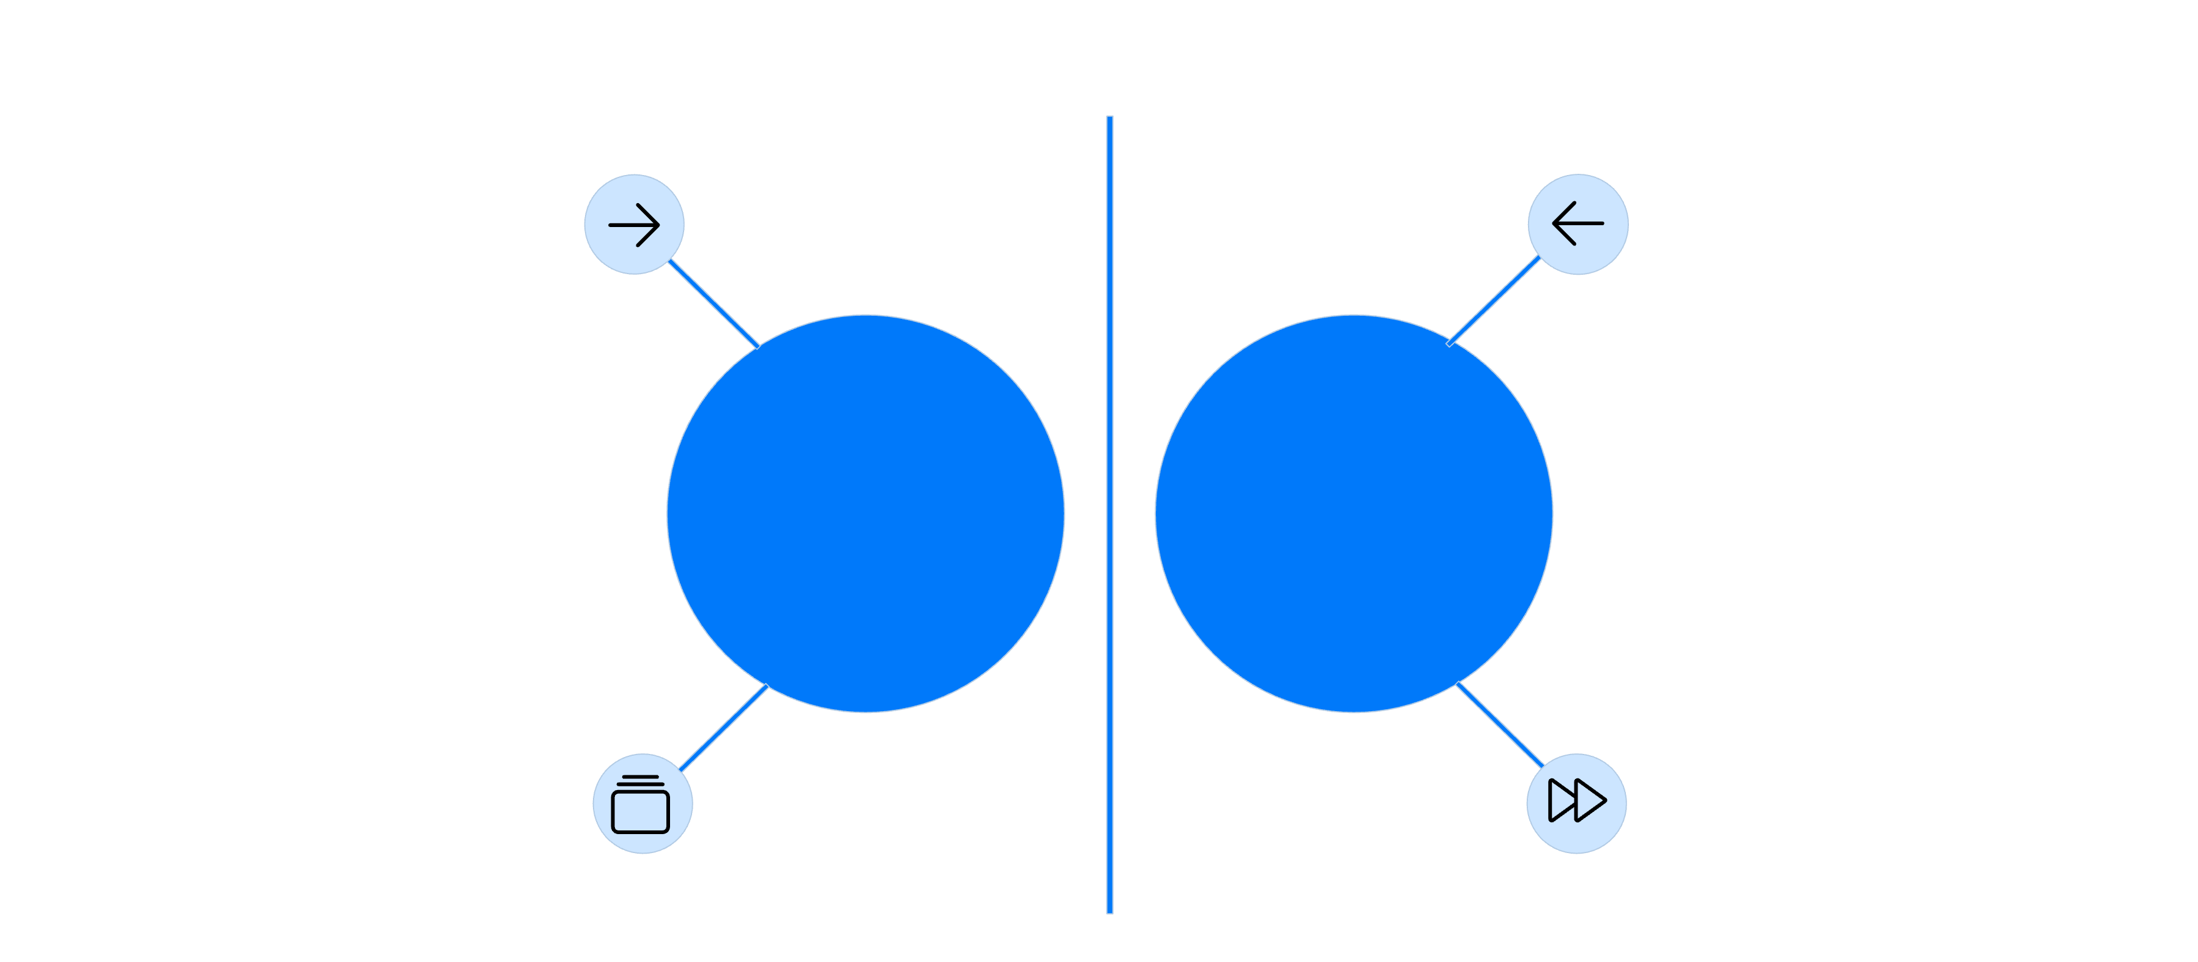





Looking Both Ways: Past and Future Context
Consider the sentence: "The bank was steep and muddy." Without full context, 'bank' might mean financial institution. With complete sentence context, we understand it means riverside slope.
Processes tokens left→right
Processes tokens right→left
Forward RNN
Backward RNN
Maintains past context
Maintains future context
Forward RNN
Backward RNN
Combined Output
Processes sequence from left to right, building context from past information.
Processes sequence from right to left, incorporating future context information.
Uses both past and future context for more accurate predictions and understanding.
Applications: Speech recognition distinguishes "I scream" vs "Ice cream", medical diagnosis considers symptoms before and after key events, document analysis understands paragraphs in full context.
Limitation: Requires complete sequence, making it unsuitable for real-time prediction applications.

Slide 11








Translation Between Different Domains
The encoder-decoder architecture works like a human translator: listen to complete sentence in Spanish (encoder), understand meaning and store in memory, then speak equivalent sentence in English (decoder).
Encoder
Compresses input sequence into fixed representation, like understanding the complete meaning of a foreign sentence.
Context Vector
Condensed summary of input information, serving as the bridge between different domains or languages.
Decoder
Generates output sequence from context, producing the final translation or transformation result.
Machine Translation
English ↔ French translation systems
Text Summarisation
Article → Summary generation
Chatbots
Question → Answer systems
Code Generation
Description → Code conversion

Slide 12

Learning with a Safety Net
Piano Learning Analogy
With Teacher: Teacher plays correct note when you make mistake, providing immediate guidance and correction.
Without Teacher: Must recover from your own mistakes, potentially compounding errors without guidance.
Teacher forcing provides the same safety net during model training.
1
2
3
Training Time
Test Time
Exposure Bias
Use correct previous output as input, ensuring model learns from ground truth rather than its own mistakes.
Use model's own predictions, which can compound errors since model wasn't trained on its mistakes.
Model not trained on its own mistakes, creating mismatch between training and inference conditions.
Text Generation Example: Target: "The cat is sleeping". Teacher forcing feeds "The" → predict "cat", feed "cat" → predict "is". Without teacher forcing: feed "The" → predict "dog", feed "dog" → predict "??"

Slide 13




Long Short-Term Memory: RNNs with Better Memory
LSTM works like a personal assistant managing information flow. The forget gate decides what to remove from memory, input gate determines what new information to store, and output gate controls what to share from memory.
Cell State
Hidden State
Three Gates
Long-term memory highway that carries important information across time steps without degradation.
Short-term working memory that processes current information and immediate context.
Control information flow: forget gate, input gate, and output gate work together seamlessly.
Medical Records Example: Remember important patient history (cell state), forget outdated information (forget gate), add new test results (input gate), share relevant info to doctor (output gate).
Key Benefit: Solves the vanishing gradient problem that plagued traditional RNNs, enabling learning of long-term dependencies.

Slide 14







How LSTM Gates Control Information Flow
Input Gate
News feed: "Add breaking news but ignore repetitive updates". Evaluates news importance, decides to add to feed.
Forget Gate
Email management: "Delete old promotional emails but keep important ones". Scans email age and importance, decides to keep or delete.
Output Gate
Weather app: "Show current conditions and relevant alerts". Checks what's relevant to user, displays selected information.
Mathematical Beauty: All gates use sigmoid function where 0 = close and 1 = open, providing gradual control rather than binary decisions. These parameters are learned automatically during training.

Slide 15


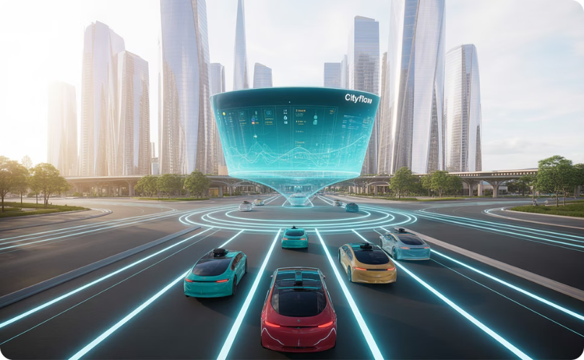

Where LSTMs Excel in Real World
Financial Forecasting
Healthcare Monitoring
Smart City Applications
Content Creation
Stock price prediction using historical data, remembering long-term trends while adapting to recent changes. Oil price forecasting considers geopolitical events.
Patient vital sign analysis over extended periods, remembering baseline health while detecting acute changes. ICU monitoring tracks patient recovery trajectories.
Traffic flow prediction for optimal routing, energy consumption forecasting for grid management. Remembers weekly patterns while adapting to special events.
Music composition remembers melody while varying rhythm. Writing assistance maintains context across paragraphs for coherent content generation.

Slide 16
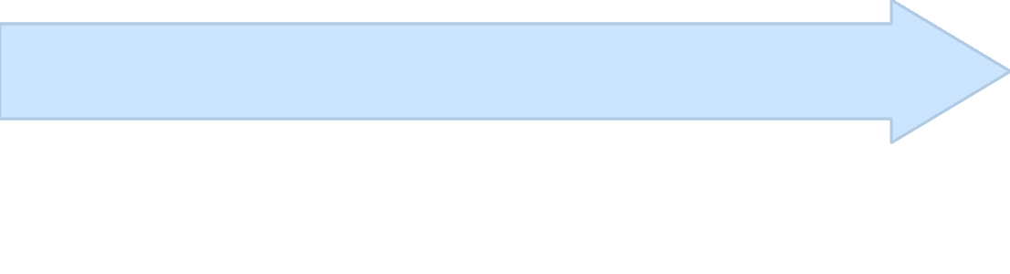

Focusing on What Matters Most
Human attention works by focusing on important sentences while reading, paying attention to relevant road signs while driving, and focusing on key words during conversation. Attention mechanisms bring this capability to neural networks.
Weight Different Parts
Allow Looking Back
Assign different importance weights to different parts of input, focusing computational resources on most relevant information.
Don't Compress Everything
Enable decoder to "look back" at any encoder state, providing direct access to relevant source information when needed.
Instead of compressing entire sequence into single vector, maintain access to all encoder states for flexible information retrieval.
Translation Example: English: "The agreement on the European Economic Area was signed". When translating "European", focus on "European" in source. When translating "signed", focus on "signed" in source.
Benefits: Better handling of long sequences, interpretable visualisation of attention weights, and foundation for Transformer architecture.

Slide 17

Making Seq2Seq Models Work in Production
Data Preparation Tips
1
Vocabulary Management: Handle unknown words gracefully. Sequence Length: Balance between too short and too long. Data Quality: Clean, consistent formatting crucial.
Training Strategies
2
Curriculum Learning: Start with simple examples. Regularisation: Dropout to prevent overfitting. Early Stopping: Prevent memorisation.
Deployment Example
3
Input Processing: Clean user messages, handle typos. Context Management: Remember conversation history. Output Filtering: Ensure appropriate responses.
Production Monitoring
4
Fallback Strategy: Human handoff when confidence low. Performance Tracking: Monitor response quality over time for continuous improvement.

Slide 18



When RNNs Struggle and How to Address It
Computational Challenges
Sequential Processing: Can't parallelise like CNNs, limiting training speed. Memory Requirements: Grows with sequence length. Training Time: Slower than feedforward networks.
Real-World Constraints
Latency: Real-time applications need fast inference. Resource Limitations: Mobile devices have memory constraints. Data Requirements: Need large amounts of sequential data.
Model Compression
Hybrid Approaches
Edge Computing
Distillation and pruning techniques reduce model size while maintaining performance for deployment efficiency.
Combine RNNs with CNNs or Transformers to leverage strengths of different architectures for optimal results.
Optimise models for deployment environment, balancing accuracy with response time and resource constraints.
Voice Assistant Example: Balance accuracy vs response time, handle diverse accents and background noise, work offline when needed.

Slide 19


From RNNs to Transformers: The Evolution Continues
1990s: Basic RNNs
1
Simple recurrent networks for basic sequence processing tasks, limited by vanishing gradient problems.
2
2000s: LSTM Revolution
Long Short-Term Memory networks solve long-term dependencies, enabling more complex sequence modelling.
2010s: Attention Mechanisms
3
Attention improves translation quality by allowing models to focus on relevant parts of input sequences.
4
2017+: Transformer Era
Transformers revolutionise NLP with parallelisation, global context, and scalability for very long sequences.
RNNs/LSTMs
Transformers
Hybrid Models
Best for small data and when sequential processing is specifically needed for the application.
Ideal for large data scenarios with available computational resources and parallel processing capabilities.
Combine strengths of both approaches for optimal performance in specific domain applications.

Slide 20




Bringing RNNs from Theory to Practice
Framework Selection
TensorFlow/Keras: User-friendly with good documentation. PyTorch: Research-friendly with dynamic computation. Specialised Libraries: Hugging Face for transformers.
Hardware Considerations
GPUs: Essential for training large models. Memory Management: Batch size vs sequence length tradeoff. Distributed Training: Multiple GPUs for large datasets.
Production Deployment
Model Serving: TensorFlow Serving, TorchServe. API Design: Handle variable-length inputs gracefully. Monitoring: Track model performance in real-time.
01
Data Collection
Gather and preprocess sequential data ensuring quality and consistency for model training.
02
Model Training
Train with validation sets, implementing proper regularisation and monitoring techniques.
03
Performance Evaluation
Assess model performance using appropriate metrics for sequential prediction tasks.
04
Deployment & Monitoring
Deploy with continuous monitoring and implement feedback loops for ongoing improvement.

Slide 21

Mastering Sequential Deep Learning
Sequential Processing
Memory Mechanisms
Understanding time-dependent data and how order matters in real-world applications and decision-making processes.
How networks remember and forget information, managing long-term and short-term dependencies effectively.
Architecture Choices
Training Strategies
When to use different RNN variants based on specific requirements and computational constraints.
Making learning efficient and effective through proper techniques and best practices implementation.
Real-World Impact
Next Steps for Learning
Communication: Machine translation, chatbots
Hands-on Practice: Implement basic RNN from scratch
Finance: Time series prediction, risk analysis
Project Work: Build end-to-end sequence models
Healthcare: Patient monitoring, drug discovery
Advanced Topics: Explore Transformer architectures
Entertainment: Content recommendation, generation
Domain Application: Apply to your specific field
Remember: Start simple, iterate quickly, and always validate with real data. The journey from basic RNNs to advanced sequence models requires patience and practice.

